Slide 1
Fibonacci Heaps
Dr. Ashish Sharma

Slide 2
Priority Queues
Heaps
Operation
Linked List
Binary
Binomial
Fibonacci †
Relaxed
make-heap
1
1
1
1
1
insert
1
log N
log N
1
1
find-min
N
1
log N
1
1
delete-min
N
log N
log N
log N
log N
union
1
N
log N
1
1
decrease-key
1
log N
log N
1
1
delete
N
log N
log N
log N
log N
is-empty
1
1
1
1
1
this time
† amortized

Slide 3
Fibonacci Heaps
Fibonacci heap history. Fredman and Tarjan (1986)
  Ingenious data structure and analysis.
  Original motivation: O(m + n log n) shortest path algorithm.
    also led to faster algorithms for MST, weighted bipartite matching
  Still ahead of its time.
Fibonacci heap intuition.
  Similar to binomial heaps, but less structured.
  Decrease-key and union run in O(1) time.
  "Lazy" unions.
Notes:
Reference: CLRS, Kozen Chapter 8-9

Slide 4
Fibonacci Heaps: Structure
Fibonacci heap.
  Set of min-heap ordered trees.
min
17
24
23
7
3
30
26
46
marked
18
52
41
35
44
H
39
Notes:
set -> unordered

Slide 5
Fibonacci Heaps: Implementation
Implementation.
  Represent trees using left-child, right sibling pointers and circular, doubly linked list.
    can quickly splice off subtrees
  Roots of trees connected with circular doubly linked list.
    fast union
  Pointer to root of tree with min element.
    fast find-min
min
17
24
23
7
3
30
26
46
18
52
41
35
44
H
39

Slide 6
Fibonacci Heaps: Potential Function
Key quantities.
  Degree[x] = degree of node x.
  Mark[x] = mark of node x (black or gray).
  t(H) = # trees.
  m(H) = # marked nodes.
  Φ(H) = t(H) + 2m(H) = potential function.
t(H) = 5, m(H) = 3
Φ(H) = 11
degree = 3
min
17
24
23
7
3
30
26
46
18
52
41
35
44
H
39
Notes:
nodes only change mark in Decrease-Key Can basically ignore marks until then.

Slide 7
Fibonacci Heaps: Insert
Insert.
  Create a new singleton tree.
  Add to left of min pointer.
  Update min pointer.
Insert 21
21
min
17
24
23
7
3
30
26
46
18
52
41
35
44
H
39

Slide 8
Fibonacci Heaps: Insert
Insert.
  Create a new singleton tree.
  Add to left of min pointer.
  Update min pointer.
Insert 21
min
17
24
23
7
21
3
30
26
46
18
52
41
35
44
H
39

Slide 9
Fibonacci Heaps: Insert
Insert.
  Create a new singleton tree.
  Add to left of min pointer.
  Update min pointer.
Running time. O(1) amortized
  Actual cost = O(1).
  Change in potential = +1.
  Amortized cost = O(1).
Insert 21
min
17
24
23
7
21
3
30
26
46
18
52
41
35
44
H
39

Slide 10
Fibonacci Heaps: Union
Union.
  Concatenate two Fibonacci heaps.
  Root lists are circular, doubly linked lists.
min
min
23
24
17
7
3
21
H'
H''
30
26
46
18
52
41
35
44
39

Slide 11
Fibonacci Heaps: Union
Union.
  Concatenate two Fibonacci heaps.
  Root lists are circular, doubly linked lists.
Running time. O(1) amortized
  Actual cost = O(1).
  Change in potential = 0.
  Amortized cost = O(1).
min
23
24
17
7
3
21
H'
H''
30
26
46
18
52
41
35
44
39

Slide 12
Fibonacci Heaps: Delete Min
Delete min.
  Delete min and concatenate its children into root list.
  Consolidate trees so that no two roots have same degree.
min
7
24
23
17
3
30
26
46
18
52
41
35
39
44

Slide 13
Fibonacci Heaps: Delete Min
Delete min.
  Delete min and concatenate its children into root list.
  Consolidate trees so that no two roots have same degree.
current
min
7
24
23
17
18
52
41
30
26
46
39
44
35

Slide 14
Fibonacci Heaps: Delete Min
Delete min.
  Delete min and concatenate its children into root list.
  Consolidate trees so that no two roots have same degree.
0
1
2
3
current
min
7
24
23
17
18
52
41
30
26
46
39
44
35

Slide 15
Fibonacci Heaps: Delete Min
Delete min.
  Delete min and concatenate its children into root list.
  Consolidate trees so that no two roots have same degree.
0
1
2
3
current
min
7
24
23
17
18
52
41
30
26
46
39
44
35

Slide 16
Fibonacci Heaps: Delete Min
Delete min.
  Delete min and concatenate its children into root list.
  Consolidate trees so that no two roots have same degree.
0
1
2
3
min
7
24
23
17
18
52
41
30
26
46
39
44
current
35

Slide 17
Fibonacci Heaps: Delete Min
Delete min.
  Delete min and concatenate its children into root list.
  Consolidate trees so that no two roots have same degree.
0
1
2
3
min
7
24
23
17
18
52
41
30
26
46
39
44
current
35
Merge 17 and 23 trees.

Slide 18
Fibonacci Heaps: Delete Min
Delete min.
  Delete min and concatenate its children into root list.
  Consolidate trees so that no two roots have same degree.
0
1
2
3
current
min
7
24
17
18
52
41
30
26
46
23
39
44
35
Merge 7 and 17 trees.

Slide 19
Fibonacci Heaps: Delete Min
Delete min.
  Delete min and concatenate its children into root list.
  Consolidate trees so that no two roots have same degree.
0
1
2
3
min
current
24
7
18
52
41
26
46
17
30
39
44
35
23
Merge 7 and 24 trees.

Slide 20
Fibonacci Heaps: Delete Min
Delete min.
  Delete min and concatenate its children into root list.
  Consolidate trees so that no two roots have same degree.
0
1
2
3
min
current
7
18
52
41
24
17
30
39
44
26
46
23
35

Slide 21
Fibonacci Heaps: Delete Min
Delete min.
  Delete min and concatenate its children into root list.
  Consolidate trees so that no two roots have same degree.
0
1
2
3
min
current
7
18
52
41
24
17
30
39
44
26
46
23
35

Slide 22
Fibonacci Heaps: Delete Min
Delete min.
  Delete min and concatenate its children into root list.
  Consolidate trees so that no two roots have same degree.
0
1
2
3
min
current
7
18
52
41
24
17
30
39
44
26
46
23
35

Slide 23
Fibonacci Heaps: Delete Min
Delete min.
  Delete min and concatenate its children into root list.
  Consolidate trees so that no two roots have same degree.
0
1
2
3
min
current
7
18
52
41
24
17
30
39
44
26
46
23
Merge 41 and 18 trees.
35

Slide 24
Fibonacci Heaps: Delete Min
Delete min.
  Delete min and concatenate its children into root list.
  Consolidate trees so that no two roots have same degree.
0
1
2
3
min
current
7
52
18
24
17
30
41
39
26
46
23
44
35

Slide 25
Fibonacci Heaps: Delete Min
Delete min.
  Delete min and concatenate its children into root list.
  Consolidate trees so that no two roots have same degree.
0
1
2
3
min
current
7
52
18
24
17
30
41
39
26
46
23
44
35

Slide 26
Fibonacci Heaps: Delete Min
Delete min.
  Delete min and concatenate its children into root list.
  Consolidate trees so that no two roots have same degree.
min
7
52
18
24
17
30
41
39
26
46
23
44
Stop.
35

Slide 27
Fibonacci Heaps: Delete Min Analysis
Notation.
  D(n) = max degree of any node in Fibonacci heap with n nodes.
  t(H) = # trees in heap H.
  Φ(H) = t(H) + 2m(H).
Actual cost. O(D(n) + t(H))
  O(D(n)) work adding min's children into root list and updating min.
    at most D(n) children of min node
  O(D(n) + t(H)) work consolidating trees.
    work is proportional to size of root list since number of roots decreases by one after each merging
    ≤ D(n) + t(H) - 1 root nodes at beginning of consolidation
Amortized cost. O(D(n))
  t(H') ≤ D(n) + 1 since no two trees have same degree.
  ΔΦ(H) ≤ D(n) + 1 - t(H).

Slide 28
Fibonacci Heaps: Delete Min Analysis
Is amortized cost of O(D(n)) good?
  Yes, if only Insert, Delete-min, and Union operations supported.
    in this case, Fibonacci heap contains only binomial trees since we only merge trees of equal root degree
    this implies D(n) ≤ ⎣log₂ N⎦
  Yes, if we support Decrease-key in clever way.
    we'll show that D(n) ≤ ⎣log_{φ} N⎦, where φ is golden ratio
    φ² = 1 + φ
    φ = (1 + √5) / 2 = 1.618…
    limiting ratio between successive Fibonacci numbers!

Slide 29
Fibonacci Heaps: Decrease Key
Decrease key of element x to k.
  Case 0: min-heap property not violated.
    decrease key of x to k
    change heap min pointer if necessary
min
7
18
38
24
17
23
21
39
41
26
46
45
30
52
Decrease 46 to 45.
35
88
72

Slide 30
Fibonacci Heaps: Decrease Key
Decrease key of element x to k.
  Case 1: parent of x is unmarked.
    decrease key of x to k
    cut off link between x and its parent
    mark parent
    add tree rooted at x to root list, updating heap min pointer
min
7
18
38
24
17
23
21
39
41
26
45
15
30
52
Decrease 45 to 15.
35
88
72

Slide 31
Fibonacci Heaps: Decrease Key
Decrease key of element x to k.
  Case 1: parent of x is unmarked.
    decrease key of x to k
    cut off link between x and its parent
    mark parent
    add tree rooted at x to root list, updating heap min pointer
min
7
18
38
24
24
17
23
21
39
41
26
15
30
52
Decrease 45 to 15.
35
88
72

Slide 32
Fibonacci Heaps: Decrease Key
Decrease key of element x to k.
  Case 1: parent of x is unmarked.
    decrease key of x to k
    cut off link between x and its parent
    mark parent
    add tree rooted at x to root list, updating heap min pointer
min
15
7
18
38
72
24
24
17
23
21
39
41
26
30
52
Decrease 45 to 15.
35
88

Slide 33
Fibonacci Heaps: Decrease Key
Decrease key of element x to k.
  Case 2: parent of x is marked.
    decrease key of x to k
    cut off link between x and its parent p[x], and add x to root list
    cut off link between p[x] and p[p[x]], add p[x] to root list
      If p[p[x]] unmarked, then mark it.
      If p[p[x]] marked, cut off p[p[x]], unmark, and repeat.
min
15
7
18
38
72
24
24
17
23
21
39
41
26
30
52
Decrease 35 to 5.
35
88
5

Slide 34
Fibonacci Heaps: Decrease Key
Decrease key of element x to k.
  Case 2: parent of x is marked.
    decrease key of x to k
    cut off link between x and its parent p[x], and add x to root list
    cut off link between p[x] and p[p[x]], add p[x] to root list
      If p[p[x]] unmarked, then mark it.
      If p[p[x]] marked, cut off p[p[x]], unmark, and repeat.
min
15
5
7
18
38
72
24
24
17
23
21
39
41
parent marked
26
30
52
Decrease 35 to 5.
88

Slide 35
Fibonacci Heaps: Decrease Key
Decrease key of element x to k.
  Case 2: parent of x is marked.
    decrease key of x to k
    cut off link between x and its parent p[x], and add x to root list
    cut off link between p[x] and p[p[x]], add p[x] to root list
      If p[p[x]] unmarked, then mark it.
      If p[p[x]] marked, cut off p[p[x]], unmark, and repeat.
min
15
5
26
7
18
38
88
24
72
24
17
23
21
39
41
parent marked
30
52
Decrease 35 to 5.

Slide 36
Fibonacci Heaps: Decrease Key
Decrease key of element x to k.
  Case 2: parent of x is marked.
    decrease key of x to k
    cut off link between x and its parent p[x], and add x to root list
    cut off link between p[x] and p[p[x]], add p[x] to root list
      If p[p[x]] unmarked, then mark it.
      If p[p[x]] marked, cut off p[p[x]], unmark, and repeat.
min
15
5
26
24
7
18
38
72
88
17
23
21
39
41
30
52
Decrease 35 to 5.

Slide 37
Fibonacci Heaps: Decrease Key Analysis
Notation.
  t(H) = # trees in heap H.
  m(H) = # marked nodes in heap H.
  Φ(H) = t(H) + 2m(H).
Actual cost. O(c)
  O(1) time for decrease key.
  O(1) time for each of c cascading cuts, plus reinserting in root list.
Amortized cost. O(1)
  t(H') = t(H) + c
  m(H') ≤ m(H) - c + 2
    each cascading cut unmarks a node
    last cascading cut could potentially mark a node
  ΔΦ ≤ c + 2(-c + 2) = 4 - c.
Notes:
When marked node y is cut by cascading cut, its mark bit is cleared (2 units of potential). One unit pays for cut, the other for unit increase in potential due to y becoming a root.

Slide 38
Fibonacci Heaps: Delete
Delete node x.
  Decrease key of x to -∞.
  Delete min element in heap.
Amortized cost. O(D(n))
  O(1) for decrease-key.
  O(D(n)) for delete-min.
  D(n) = max degree of any node in Fibonacci heap.

Slide 39
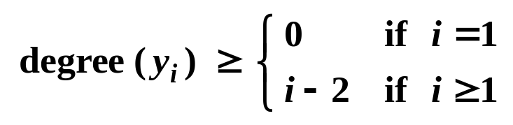
Fibonacci Heaps: Bounding Max Degree
Definition. D(N) = max degree in Fibonacci heap with N nodes.
Key lemma. D(N) ≤ log_{φ} N, where φ = (1 + √5) / 2.
Corollary. Delete and Delete-min take O(log N) amortized time.
Lemma. Let x be a node with degree k, and let y₁, . . . , y_{k} denote the children of x in the order in which they were linked to x. Then:
Proof.
  When y_{i} is linked to x, y₁, . . . , y_{i-1} already linked to x,
  ⇒ degree(x) = i - 1
  ⇒ degree(y_{i}) = i - 1 since we only link nodes of equal degree
  Since then, y_{i} has lost at most one child
    otherwise it would have been cut from x
  Thus, degree(y_{i}) = i - 1 or i - 2

Slide 40
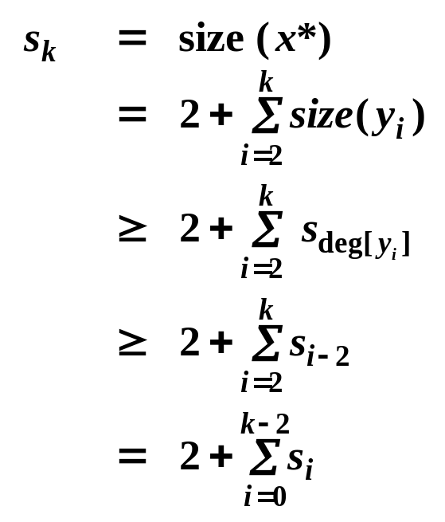
Fibonacci Heaps: Bounding Max Degree
Key lemma. In a Fibonacci heap with N nodes, the maximum degree of any node is at most log_{φ} N, where φ = (1 + √5) / 2.
Proof of key lemma.
  For any node x, we show that size(x) ≥ φ^{degree(x)} .
    size(x) = # node in subtree rooted at x
    taking base φ logs, degree(x) ≤ log_{φ} (size(x)) ≤ log_{φ} N.
  Let s_{k} be min size of tree rooted at any degree k node.
    trivial to see that s₀ = 1, s₁ = 2
    s_{k} monotonically increases with k
  Let x* be a degree k node of size s_{k},
  and let y₁, . . . , y_{k} be children in order
  that they were linked to x*.
Assume k ≥ 2
Notes:
2 comes from node x* (1) and child of x* with degree 1

Slide 41
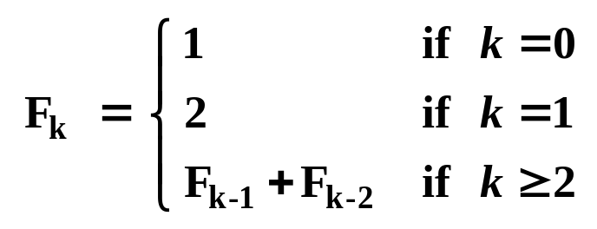
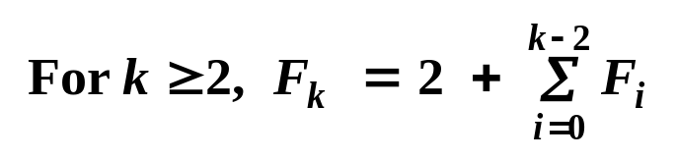
Fibonacci Facts
Definition. The Fibonacci sequence is:
  1, 2, 3, 5, 8, 13, 21, . . .
  Slightly nonstandard definition.
Fact F1. F_{k} ≥ φ^{k}, where φ = (1 + √5) / 2 = 1.618…
Fact F2.
Consequence. s_{k} ≥ F_{k} ≥ φ^{k}.
  This implies that size(x) ≥ φ^{degree(x)}
  for all nodes x.

Slide 42
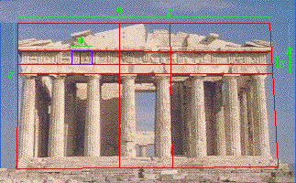
Golden Ratio
Definition. The Fibonacci sequence is: 1, 2, 3, 5, 8, 13, 21, . . .
Definition. The golden ratio φ = (1 + √5) / 2 = 1.618…
  Divide a rectangle into a square and smaller rectangle such that the smaller rectangle has the same ratio as original one.
Parthenon, Athens Greece

Slide 43
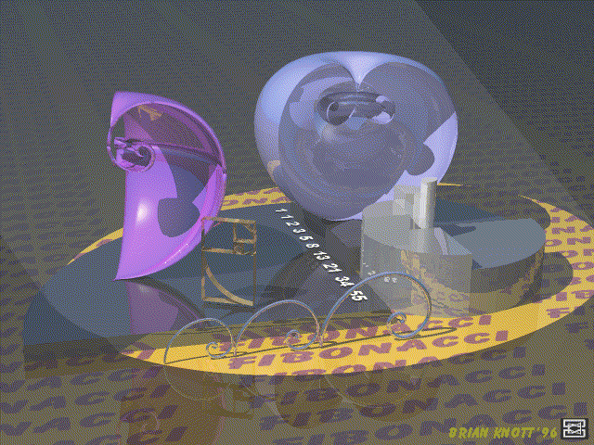
Fibonacci Facts
Notes:
This image uses shapes derived from the Fibonacci series. The grey shiny base shows the individual quarter-circles which make up the Fibonacci spiral, and increases the height of each quarter-circle as they get smaller in radius. The purple object on the left of the image is a Fibonacci spiral rotated through 90 degrees about a point on the edge common to the square of size 3 and the square of size 13, furthest away from the square of size 2. The axis of rotation is the longest edge of the rectangle made from the squares which make up the spiral. The light blue object to the right is similar to the purple one, but rotated through 239 degrees. The object at the front of the purple one is the Fibonacci spiral plus the squares used in its construction, given a thickness to make them appear to be made from brass strips. The three objects in front of the base are the spiral as it would appear when made from chromed rod.
This ray-tracing was done on a 486 DX66 PC, using Imagine 3.0.
If you have any comments or suggestions relating to this image, please email Brian Knott at brianknott@wirral.gov.uk)

Slide 44
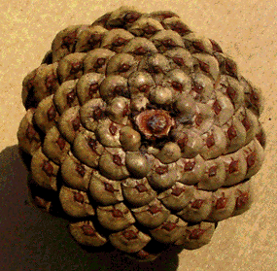
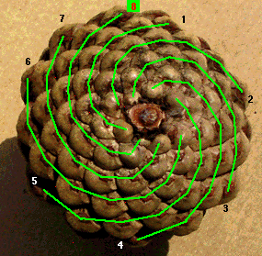
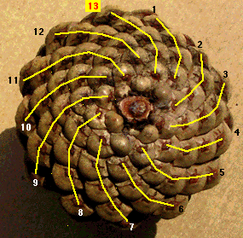
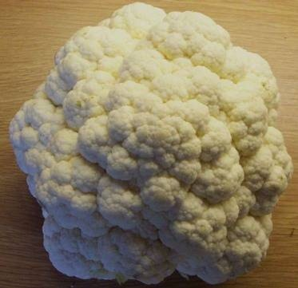
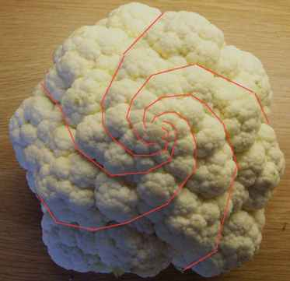

Fibonacci Numbers and Nature
Pinecone
Cauliflower
Notes:
http://www.mcs.surrey.ac.uk/Personal/R.Knott/Fibonacci/fibnat.html

Slide 45
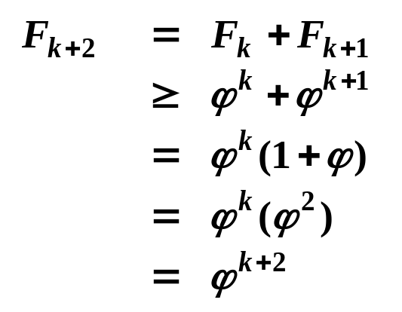
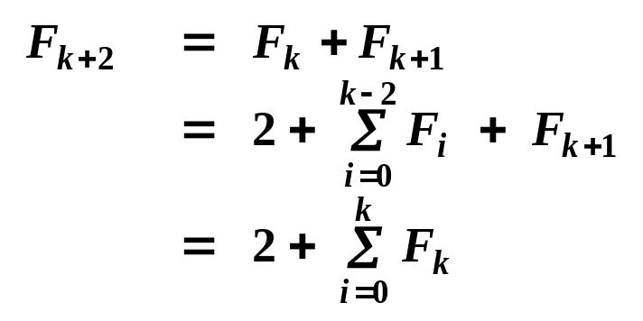
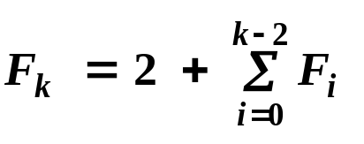
Fibonacci Proofs
Fact F1. F_{k} ≥ φ^{k}.
Proof. (by induction on k)
  Base cases:
    F₀ = 1, F₁ = 2 ≥ φ.
  Inductive hypotheses:
    F_{k} ≥ φ^{k} and F_{k+1} ≥ φ^{k+1}
Fact F2.
Proof. (by induction on k)
  Base cases:
    F₂ = 3, F₃ = 5
  Inductive hypotheses:
φ² = φ + 1

Slide 46

On Complicated Algorithms
"Once you succeed in writing the programs for [these] complicated algorithms, they usually run extremely fast. The computer doesn't need to understand the algorithm, its task is only to run the programs."
R. E. Tarjan

